Slide 1
College Managing System
Developed By:Manjyot Singh
Id:5262028

Slide 2
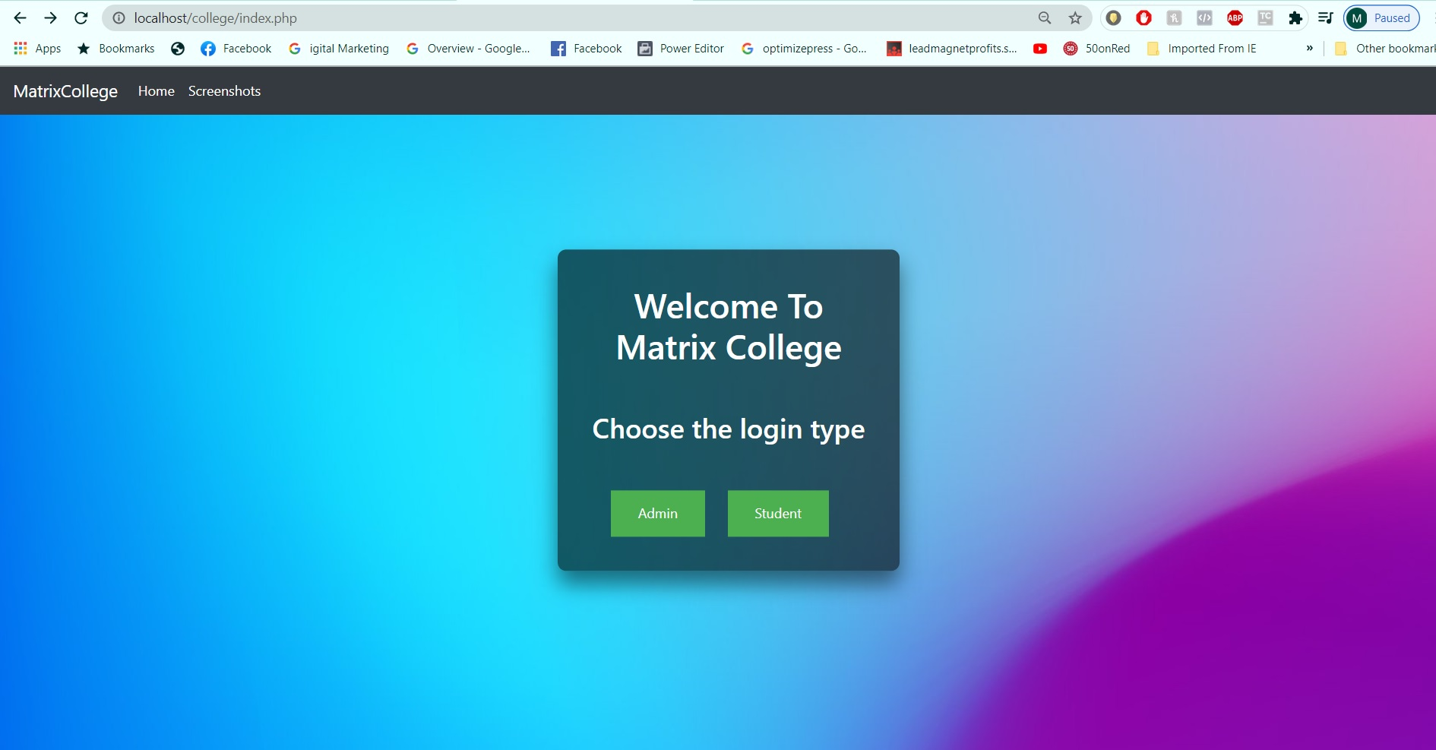
Landing Page
It’s a simple Page showing 2 different sign-in option for the user either as an Admin/Student.
For creating this web page I used Css property from bootsrap to add the nav bar.
By the help of javascript I was able to redirect user to desired login page.

Slide 3
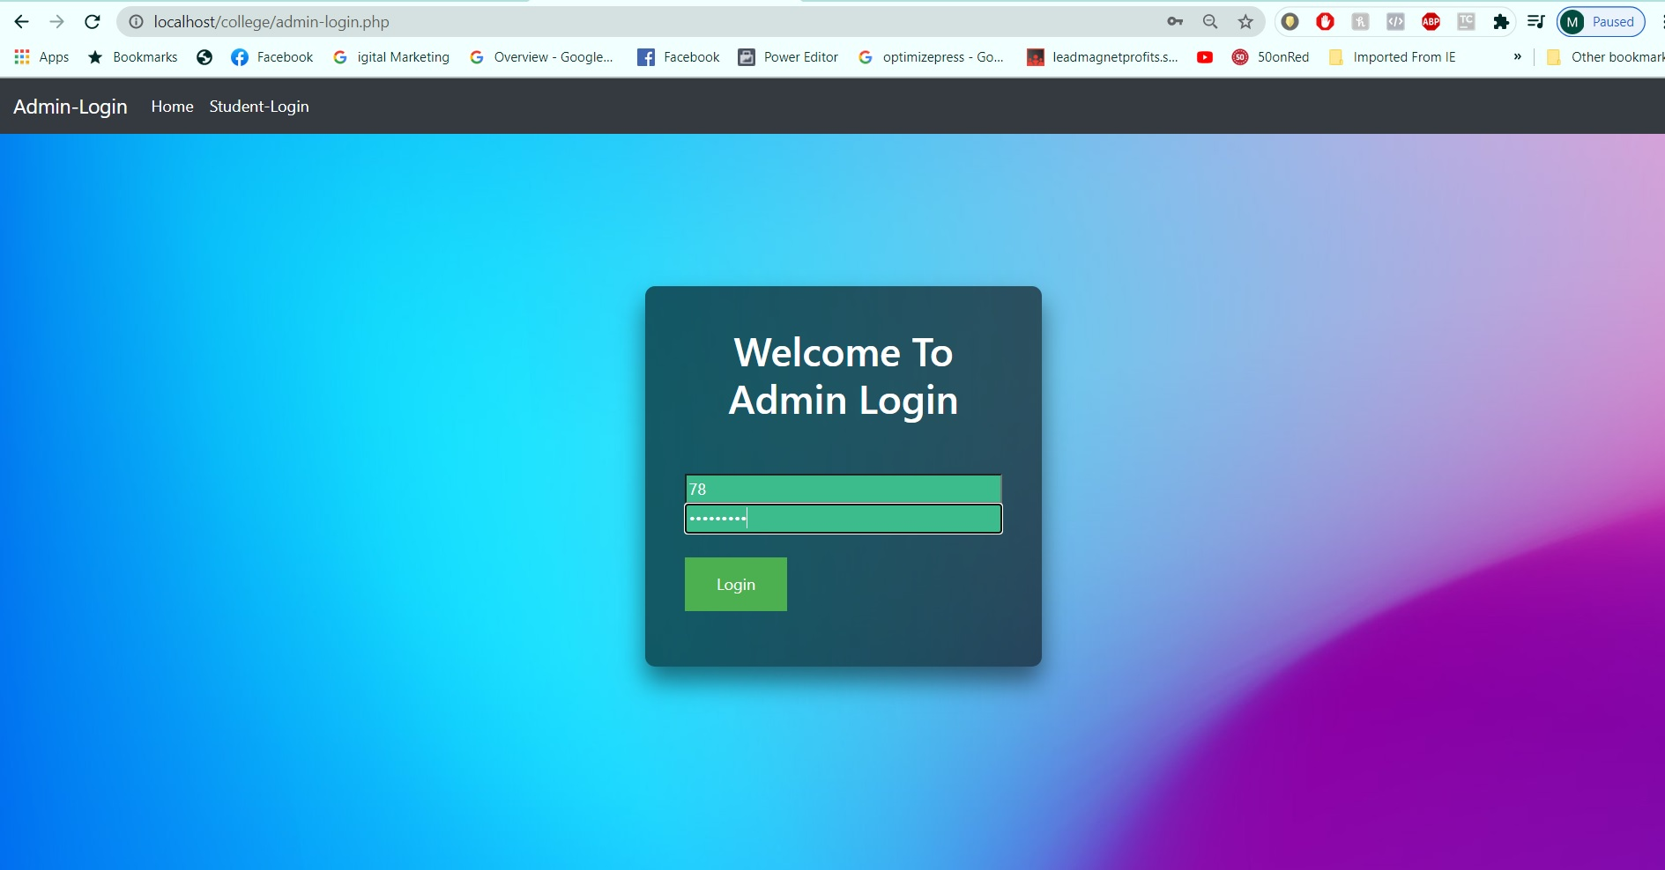
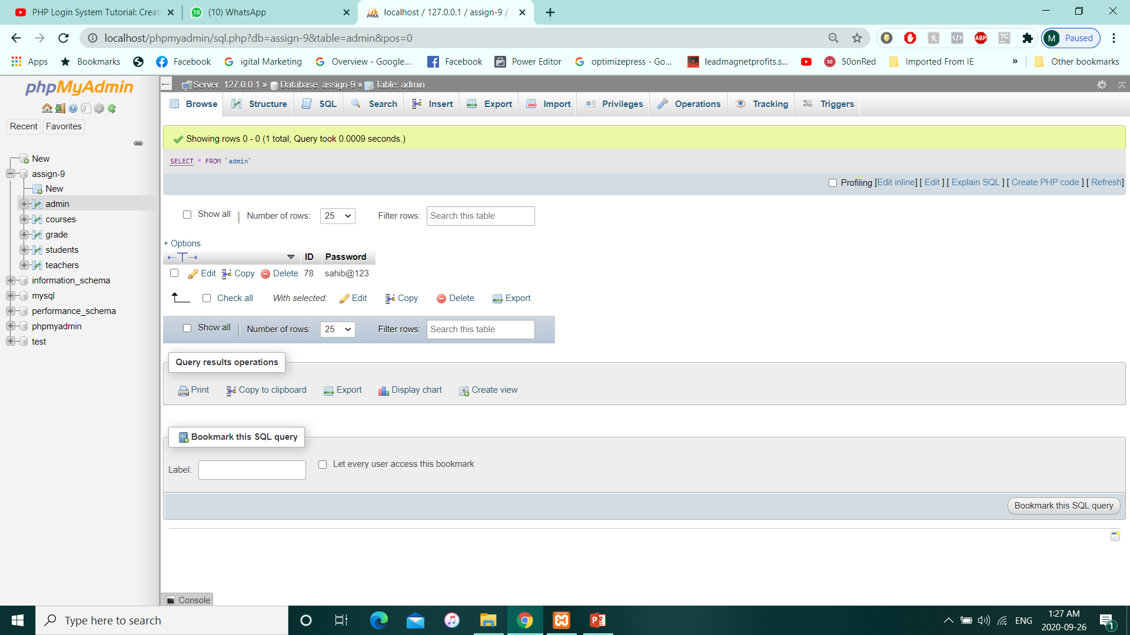
Login Page
Here’s is an example how the website delivers webpage according to the user preference.
Here I prestored the admin data in the table
Values=id(78)
Password(sahib@123)

Slide 4
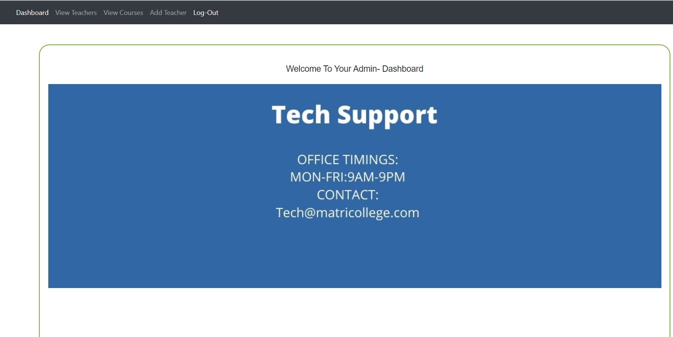
Admin-Dashboard
If admin has right credentials,he will
be redirected to their Dashboard with these options.
1.)View Teachers: To view all teachers in a current system.
2.)View Courses:TO View courses being offered by college.
3.)Add Teacher:To Add a teacher in a system.

Slide 5
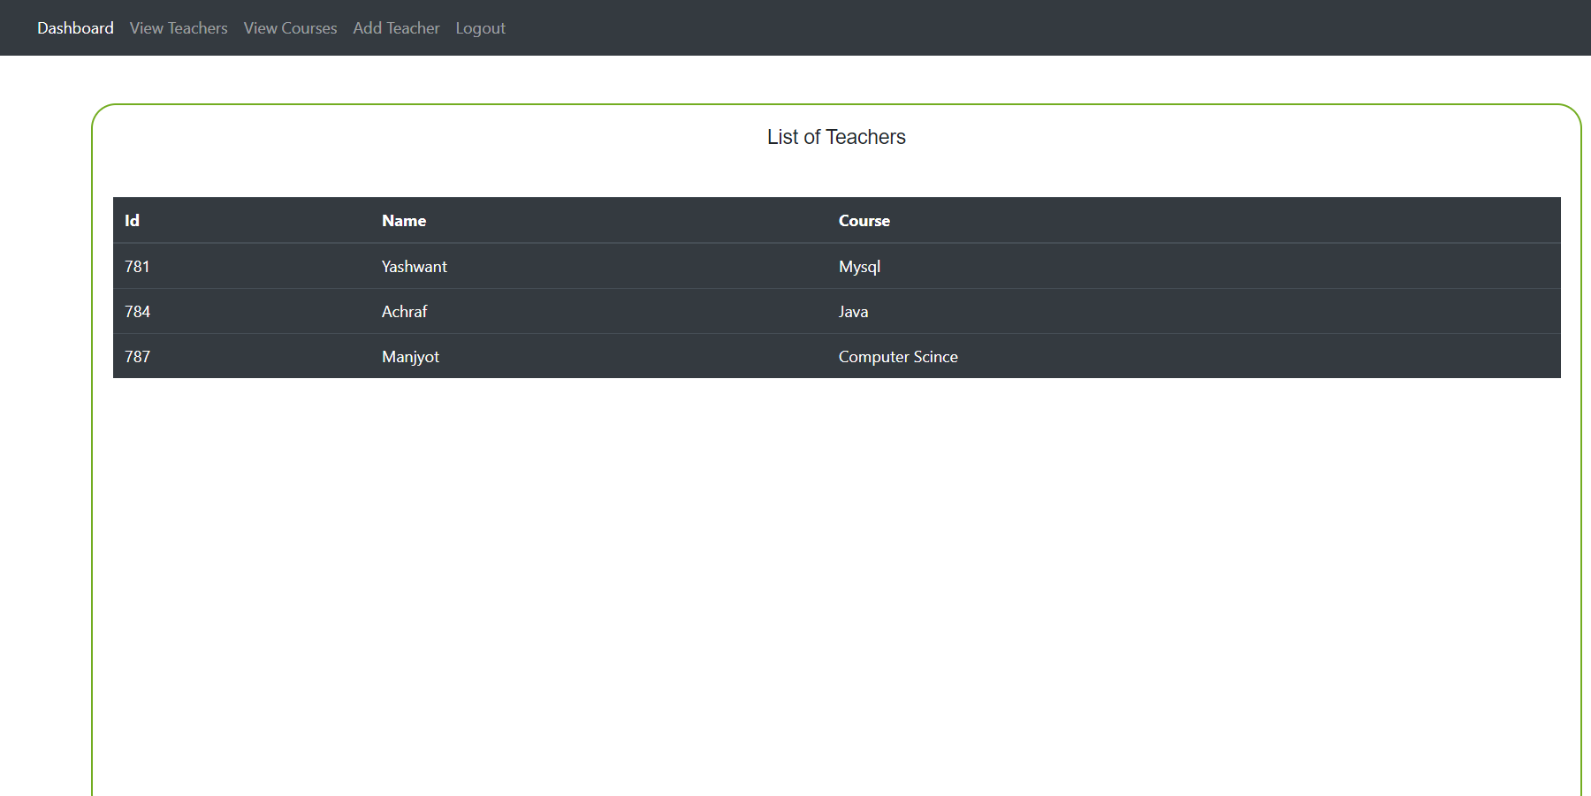
View Teachers

Slide 6
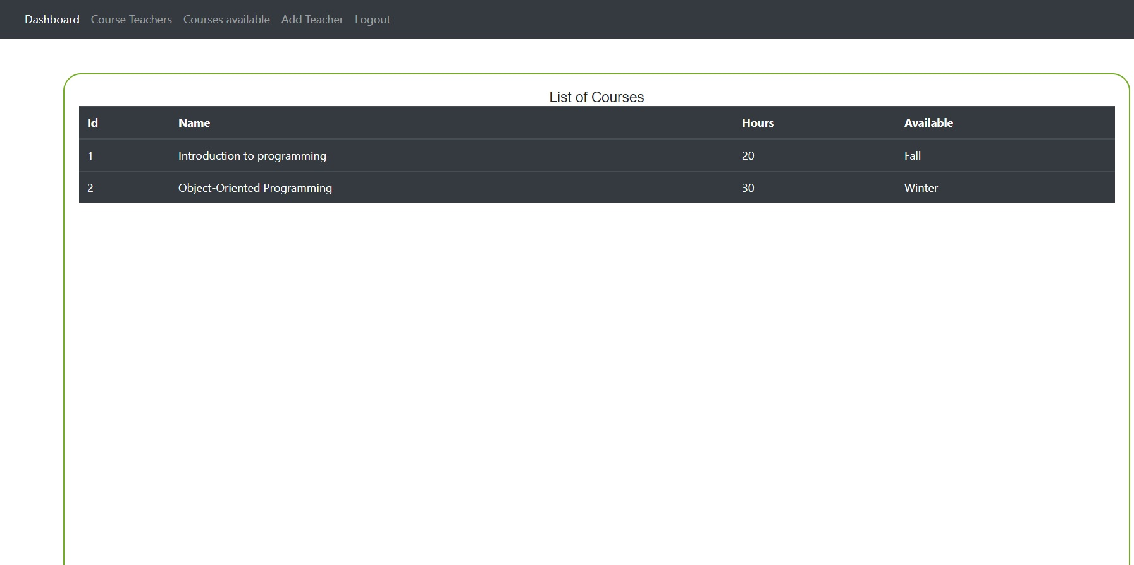
View Courses

Slide 7
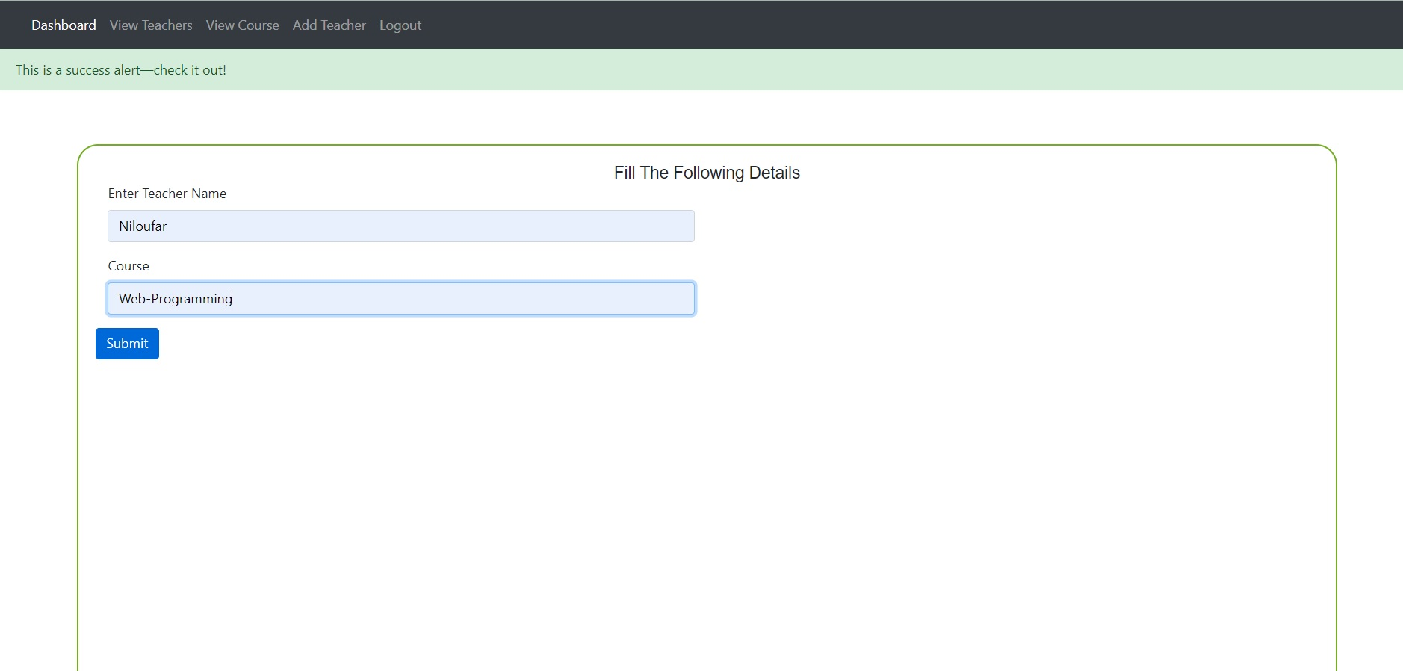
Add Teacher

Slide 8
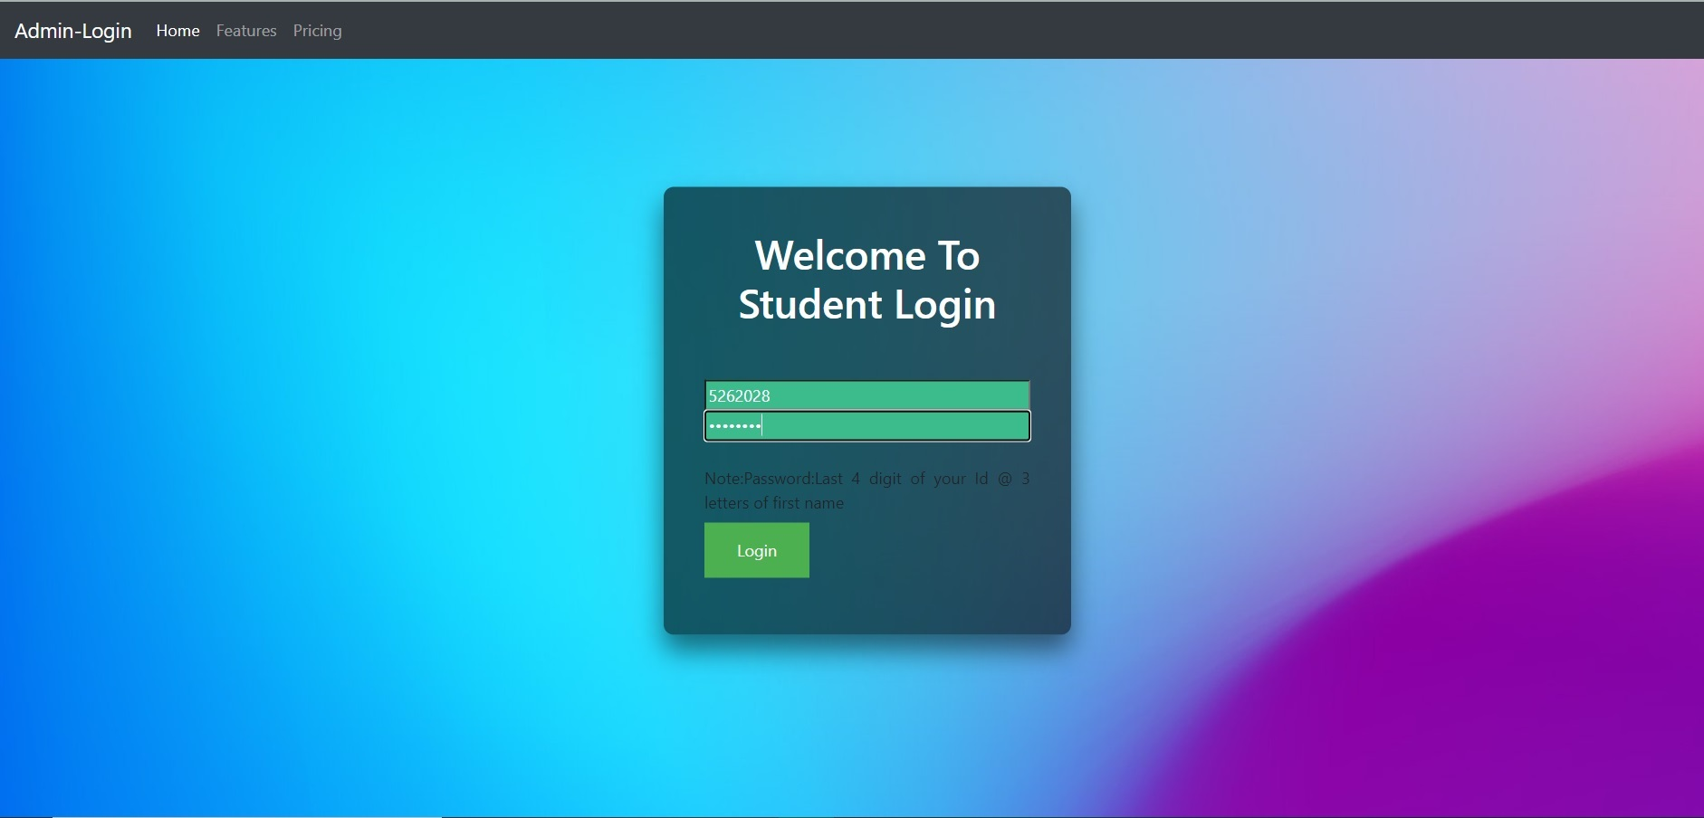
Student Login:
Here is the login page for student:
Credentials required are
1.)StudentId
2.)Password(For password its combination of Last 4 digit for studentId@first 3 letters of first name.

Slide 9
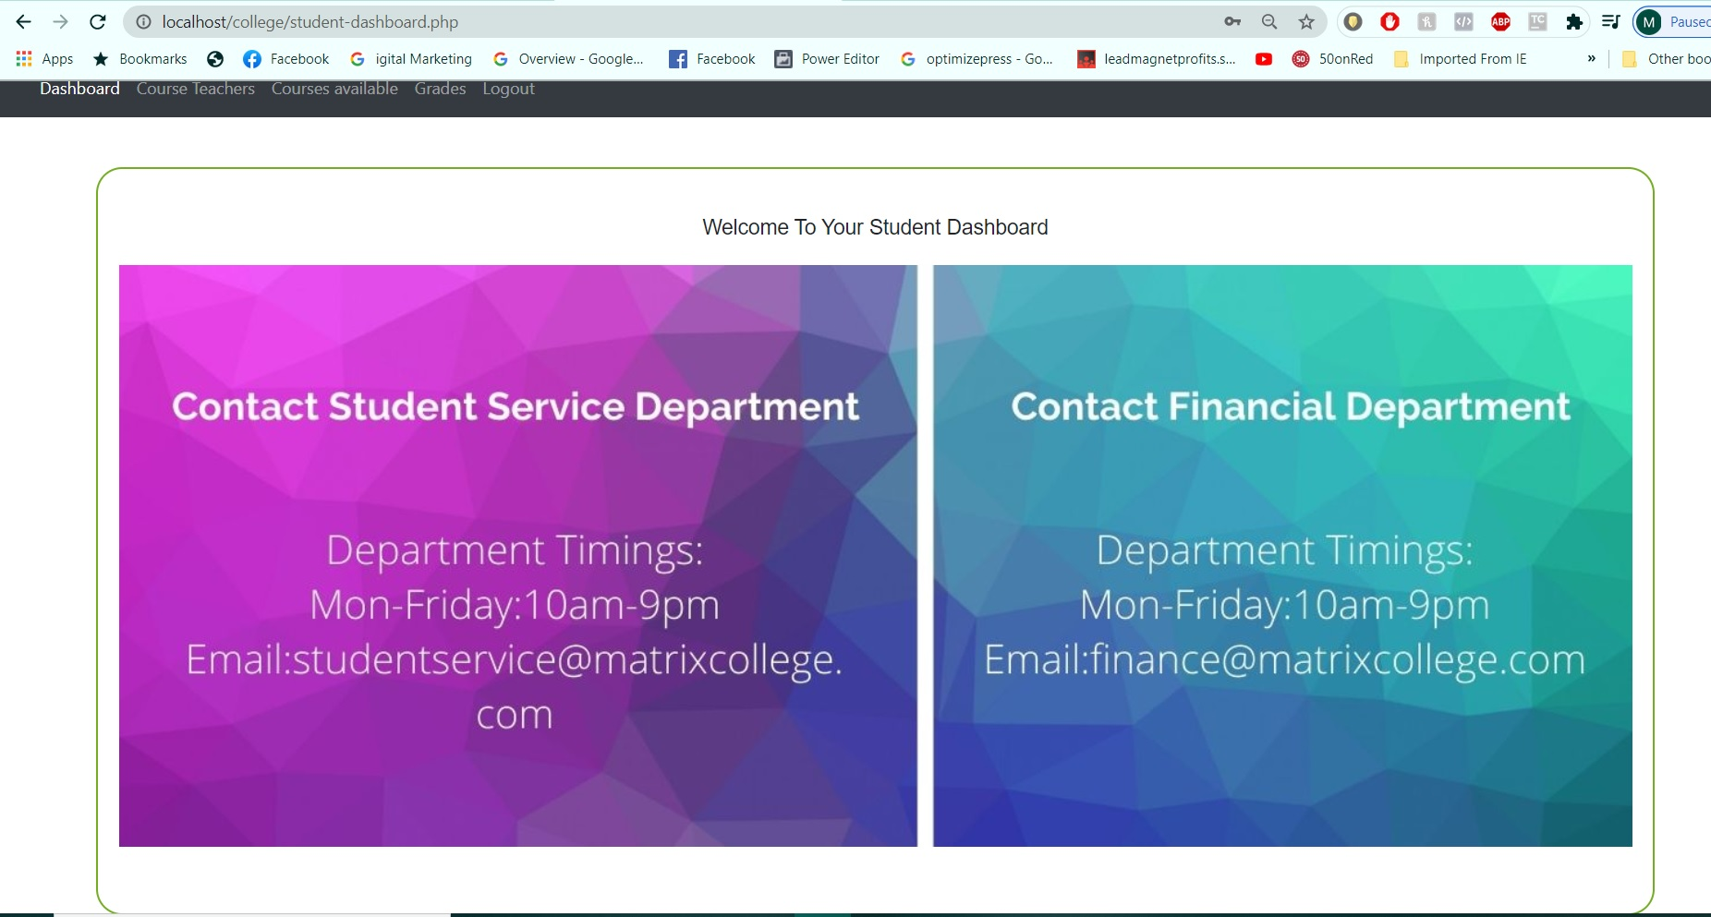
Student Dashboard
Here is the student dashboard with similar option of admin except making changes to system and in addition it shows grades of student

Slide 10
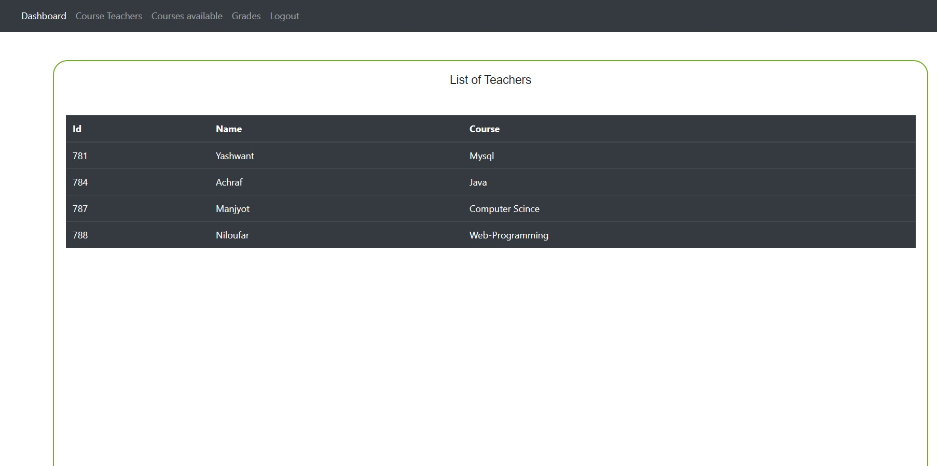
Changes Made in Teachers in Admin:

Slide 11
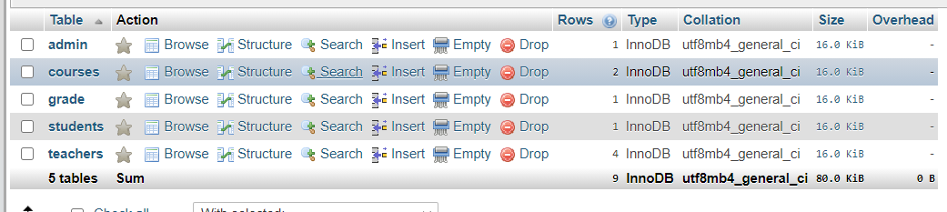
Databases and tables

